Slide 1
Streamlining AKS Debugging: Techniques to solve common & complex problems
Aritra Ghosh, Jose Blanquicet, Juan-Lee Pang
Notes:
Welcome everyone! Hope you are all having a great time at Build. Today, we’re diving into one of the most critical aspects of running Kubernetes at scale—debugging in Azure Kubernetes Service (AKS).”
“This session is all about practical techniques—we’ll walk through real-world issues, patterns, and tooling that help resolve both frequent edge cases and deep, systemic problems in AKS clusters What You’ll Walk Away With
“Clear mental models and workflows to debug AKS issues.”
“Lesser-known but powerful tools and tricks built into AKS or available via Azure integrations.”
“Confidence in dealing with high-severity issues in your clusters.

Slide 2
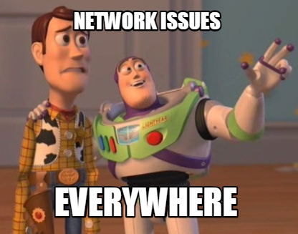
Scenario 1: Troubleshooting Network Issues
Meme Creator

Slide 3
Focus on DNS and TCP
What happens during a typical network connection?
DNS resolution (translating domain name to IP addresses)
TCP/UDP transport setup
Application-layer communication (e.g., HTTPs, gRPC)
Notes:
Why DNS and TCP?
DNS & TCP are present every time you use HTTPs, gRPC and most of high-level protocols.
AND
It is hard to debug them in K8s because
If you are able to SSH into the nodes (not always possible), standard Linux tools are not k8s aware
For instance, if you managed to run tcpdump:
it might not capture all the traffic of your containers (diff linux network namespace)
You will need to correlate output from diff nodes
Doable but not really the easiest task
The goal of the following demos is to show you how to simplify that debugging process

Slide 4
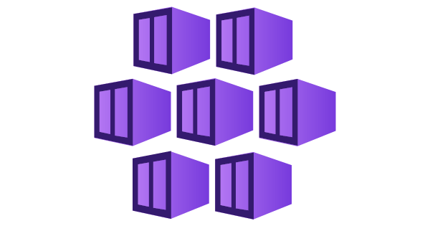

Debugging Tools
Kubernetes
Status, Logs, etc.
Real-Time debugging with Inspektor Gadget
Notes:
For the demo, we will be using all info provided by k8s, paritcularly logs ... And IG

Slide 5









Inspektor Gadget
Linux OS
AKS Cluster
Linux OS
Troubleshooting
Monitoring
Security
Inspektor-gadget.io
Notes:
Let me briefly introduce you IG before using it
It is an open source project for troubleshooting, monitoring and security.
It is extensible through a set of tools that we call Gadget
Those Gadgets can be used in the three diff areas I mentioned:
1) troubleshooting for real-time debuggin:
This is what I'm going to demo today for debugging TCP and DNS issues
2) Monitoring: for generating custom metrics to build your own Grafana dashboards:
It can be used either Azure Manage Grafana or open-source Grafana
Or any OTEL compatible collector
And third, gor identifying malicious behaviors
For instance to create Prometheus alerts based on the metrics you generate with IG
One of the features that makes IG suitable for debuggin k8s issues is that it's k8s aware:
Remember the issues we mention before?
With IG every single event is enriched with k8s metadata
Able to filter by k8s resources: ns, pod ...

Slide 6
Demo

Slide 7
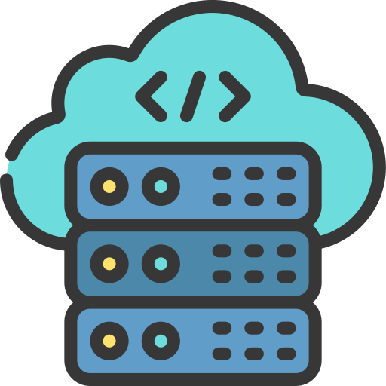

App Architecture
6
External
endpoint
*
5
order-service
rabbitmq
4
1
2
Customer
Store-front
ingress
store-front
service
3
product-service
AKS Cluster
Wireframe Icons & Symbols
IconCloud

Slide 8
Flowchart: Entry-point
External
endpoint
order-service
rabbitmq
Customer
store-front
ingress
store-front
service
product-service
AKS Cluster
Wireframe Icons & Symbols
IconCloud

Slide 9
Flowchart: Building the front-end
External
endpoint
order-service
rabbitmq
Customer
store-front
ingress
store-front
service
product-service
AKS Cluster
Wireframe Icons & Symbols
IconCloud

Slide 10

Flowchart: Checkout an order (Back-end)
External
endpoint
order-service
rabbitmq
Customer
store-front
ingress
store-front
service
product-service
AKS Cluster
Wireframe Icons & Symbols
IconCloud

Slide 11
How the service works?
containerPort
3000
Forward to
targetPort
3000
store-front
pod
order-service
service
order-service
pod
Service
port
AKS Cluster
Wireframe Icons & Symbols
IconCloud

Slide 12
Issue: Wrong service configuration
Service
Target port
Container port
3000
3001
3000
store-front
service
order-service
service
order-service
pod
Service
port
AKS Cluster
Wireframe Icons & Symbols
IconCloud

Slide 13
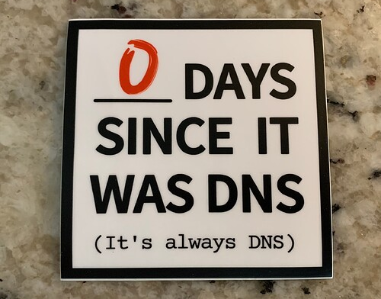
Troubleshooting DNS in AKS
Its always DNS lol – Humor – It’s FOSS Community

Slide 14

Context: Components involved in a DNS resolution
Upstream DNS
(e.g., Azure or custom DNS)
MyApp
(e.g., order-service)
kube-dns
service
AKS Cluster
Wireframe Icons & Symbols
IconCloud
Notes:
These are the components involved in a DNS resolution within AKS:
- The kube-dns service
The Upstream DNS (AKS or custom DNS). Notice it's not always involved. For instance ...

Slide 15

DNS: Local endpoints
Upstream DNS
(e.g., Azure or custom DNS)
lookup another-service
1
order-service
kube-dns
service
2
another-service
AKS Cluster
Wireframe Icons & Symbols
IconCloud

Slide 16
DNS: External endpoints
3
2
External
endpoint
Upstream DNS
(e.g., Azure or custom DNS)
1
lookup externalendpoint.com
order-service
kube-dns
service
AKS Cluster
Wireframe Icons & Symbols
IconCloud

Slide 17
Demo

Slide 18
Demo: Simulate an issue with the external endpoint
External
endpoint
order-service
rabbitmq
Customer
store-front
ingress
store-front
service
product-service
AKS Cluster
Wireframe Icons & Symbols
IconCloud

Slide 19
Demo: Order-service <-> kube-dns
Custom DNS
lookup myexternalendpoint.com
Order-service
kube-dns
service
AKS Cluster
Wireframe Icons & Symbols
IconCloud

Slide 20
Demo: Kube-dns <-> Custom DNS
lookup myexternalendpoint.com
Custom DNS
Order-service
kube-dns
service
AKS Cluster
Wireframe Icons & Symbols
IconCloud

Slide 21
Issue: Wrong custom DNS configuration
kube-dns service
Custom DNS
Query myexternalendpoint.com
Query myexternalendpoint.com
Query
microsoft.com
Time
Response
microsoft.com
Query myexternalendpoint.com
Wireframe Icons & Symbols
IconCloud

Slide 22
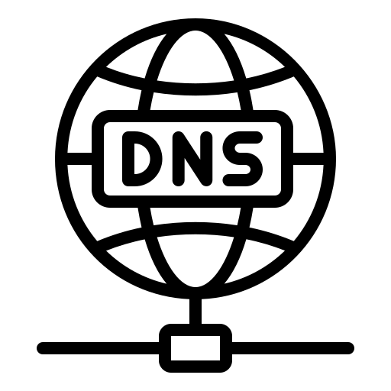


Issue: Wrong custom DNS configuration
kube-dns
service
Custom DNS
Query (Q) myexternalendpoint.com
kubectl gadget run trace_dns …
Query(Q) myexternalendpoint.com
Time
Query (Q)
microsoft.com
Response (R)
microsoft.com
Query (Q) myexternalendpoint.com
Proactive Monitoring
Wireframe Icons & Symbols
IconCloud

Slide 23
Takeaways
Isolate
Using an inside-out approach streamlines troubleshooting
Start from one app and then see how it interacts with other etc.
Tools & data
Logs – valuable source of information to start the analysis with
Inspektor Gadget
Interactive & multipurpose (security, networking, performance, etc.)
Alternative tools: Advanced Container Networking Services
Hubble enriched metrics w/ prebuilt managed Grafana dashboards
Network flow logs for Log Analytics and external logging (e.g., Otel)
And that’s not all that Inspektor Gadget does…
Use manifest files for common troubleshooting scenarios
Customize the collected data: Create your own Gadget
… and more inspektor-gadget.io
Notes:
Isolate
Remember what we did:
Divide our environment into segments, focus on entrypoint, check logs, interaction …
Tools
- As an alternative tool: if you are interested only in networking enriched metrics & logs and support also Windows, then you should check ACNS.
That’s not all IG does ...
- IG provides several gadgets for diff use cases, but
if they don’t fit your use case,
IG can also be used as a framework to run your own gadget
for troubleshooting, monitoring or security

